Slide 1
ASSIGNMENT 6
GROUP 1:
Sruthy Krishnan(c0749122)
PROJECT TITLE : IOT BASED SMART PARKING USING BEAGLEBONE WIRELESS

Slide 2
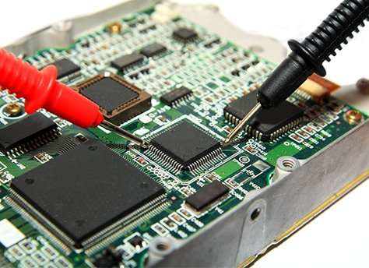

Testing Each hardware parts:
TESTING BEAGLEBONE BLACK WIRELESS
TESTING 16x2 LCD DISPLAY
TESTING HC-SR04 ULTRASONIC SENSOR
TESTING ADAFRUIT ULTIMATE GPS BREAKOUT MODULE
TESTING 28BYJ-48 STEPPER MOTOR AND ULN2003 DRIVER BOARD

Slide 3
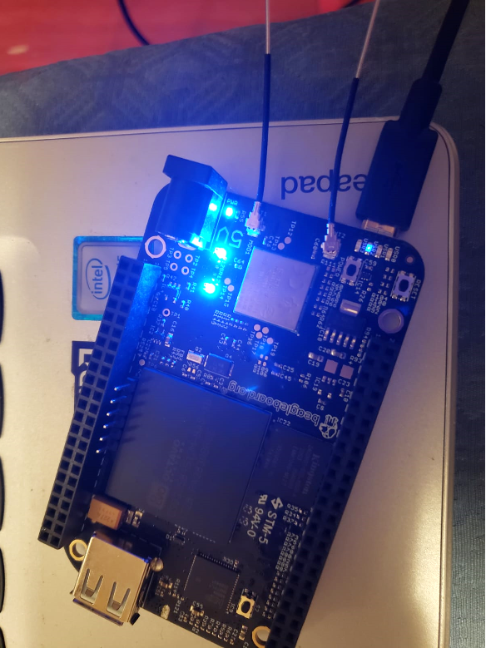
Testing BEAGLEBONE black wireless
Connected Beaglebone Black Wireless to the laptop using a micro USB connector
Log on as debian@beaglebone using “ssh 192.168.7.2 –l debian” command on the terminal window and its default password is “temppwd”
Checked the Linux Kernel version using “uname –a” command
Established WiFi connection using “sudo connmanctl” command and tested the network connection by pinging Google.

Slide 4
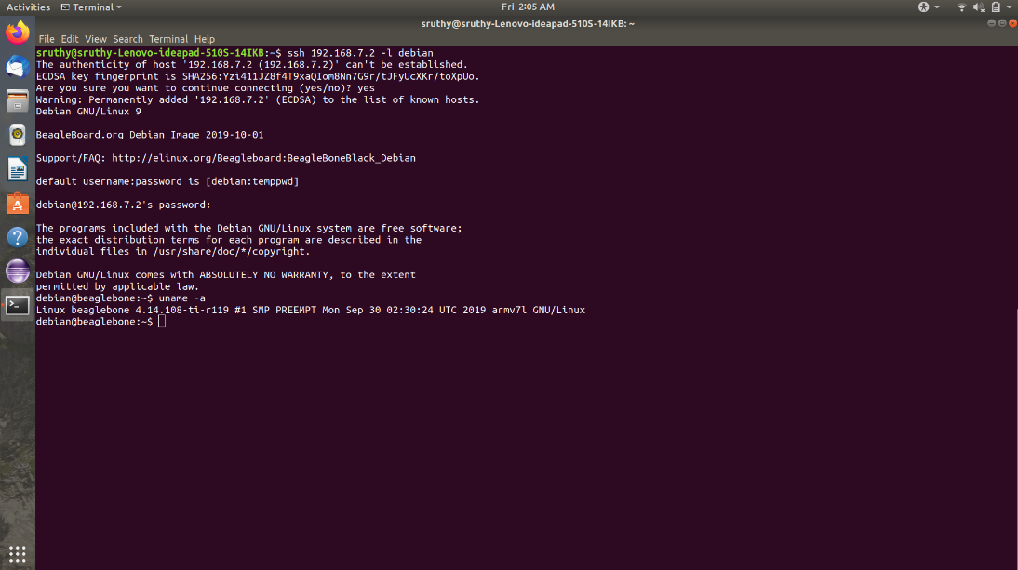

Slide 5
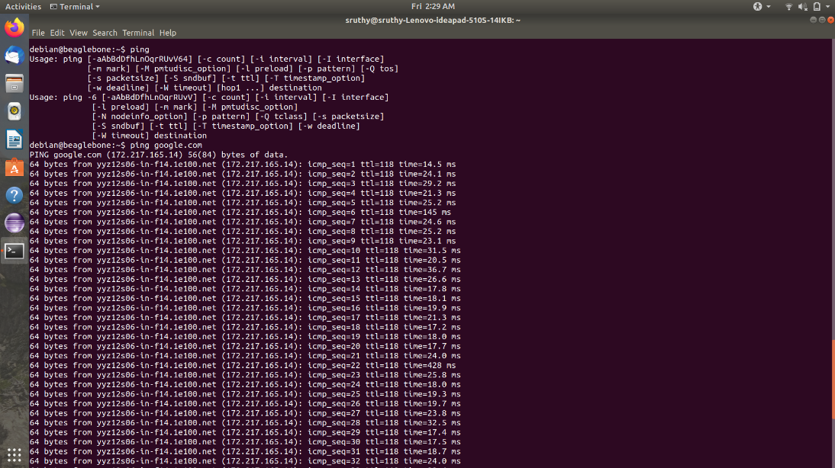

Slide 6
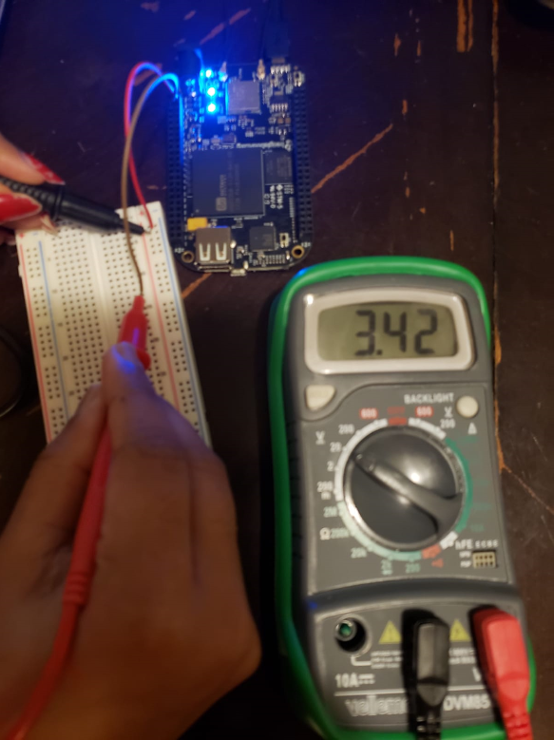
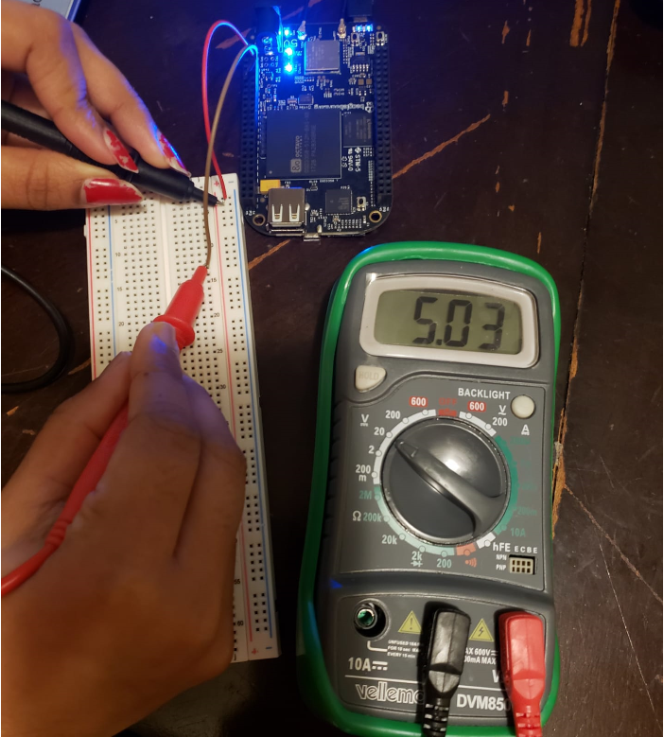
Checked and verified the voltage at VDD 3.3V (Pin 3 and 4 of P9) and SYS 5V (Pin 7 and 8 of P9) using a multimeter
VDD 3.3V (Pin 3 and 4)
SYS 5V (Pin 7 and 8)

Slide 7
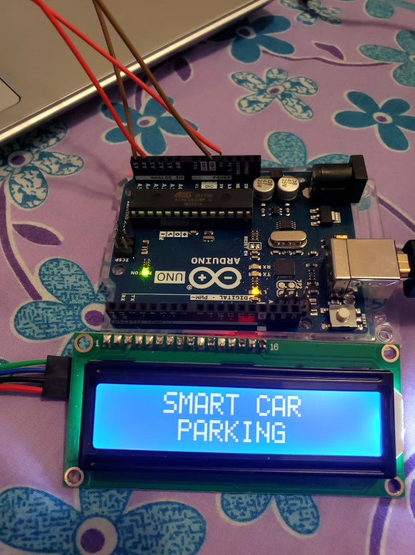
Testing 16X2 LCD DISPLAY
Testing of 16x2 LCD display was done by connecting it to Arduino UNO
LCD connections
LCD 16x2 Arduino
GND ←→ GND
VCC ←→ 5V
SDA ←→ A4
SCL ←→ A5
Displayed “Smart Car Parking” on the LCD screen by running a simple code on Arduino IDE
Contrast adjustment is done with the help of potentiometer

Slide 8
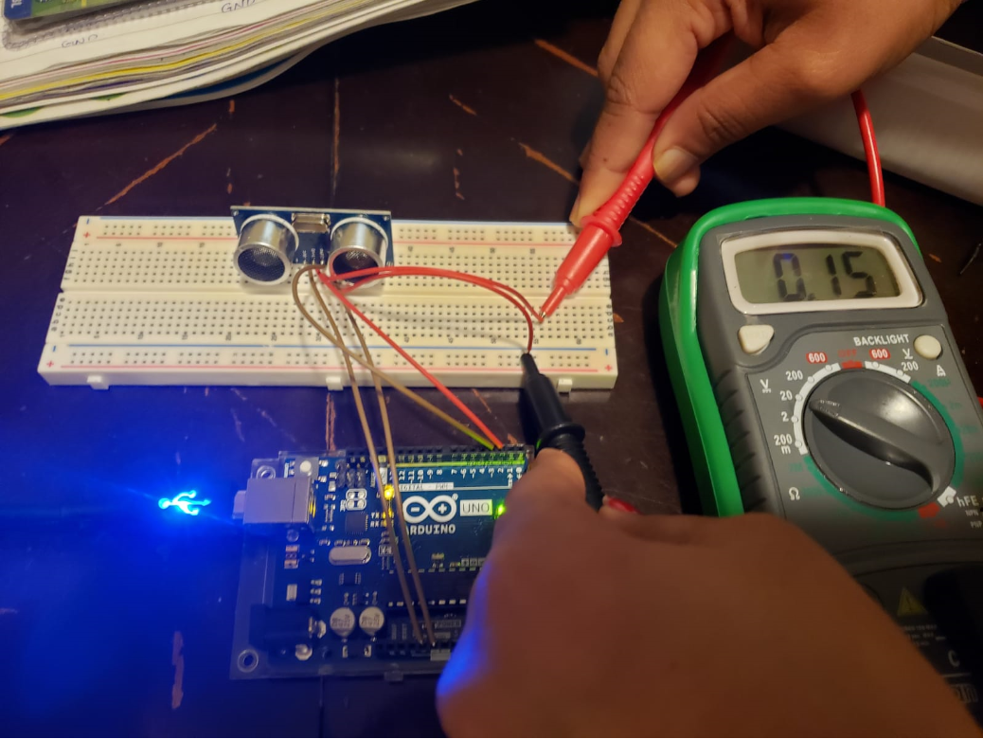
Testing hc-sr04 ultrasonic sensor
Testing is done by connecting it to Arduino UNO
Sensor connections
HC-SR04 Arduino
VCC ←→ 5V
Trig ←→ Pin 2
Echo ←→ Pin 3
GND ←→ GND
Measured the voltage at the Echo pin using a digital multimeter and verified that voltage decreases with increase in distance to the object

Slide 9
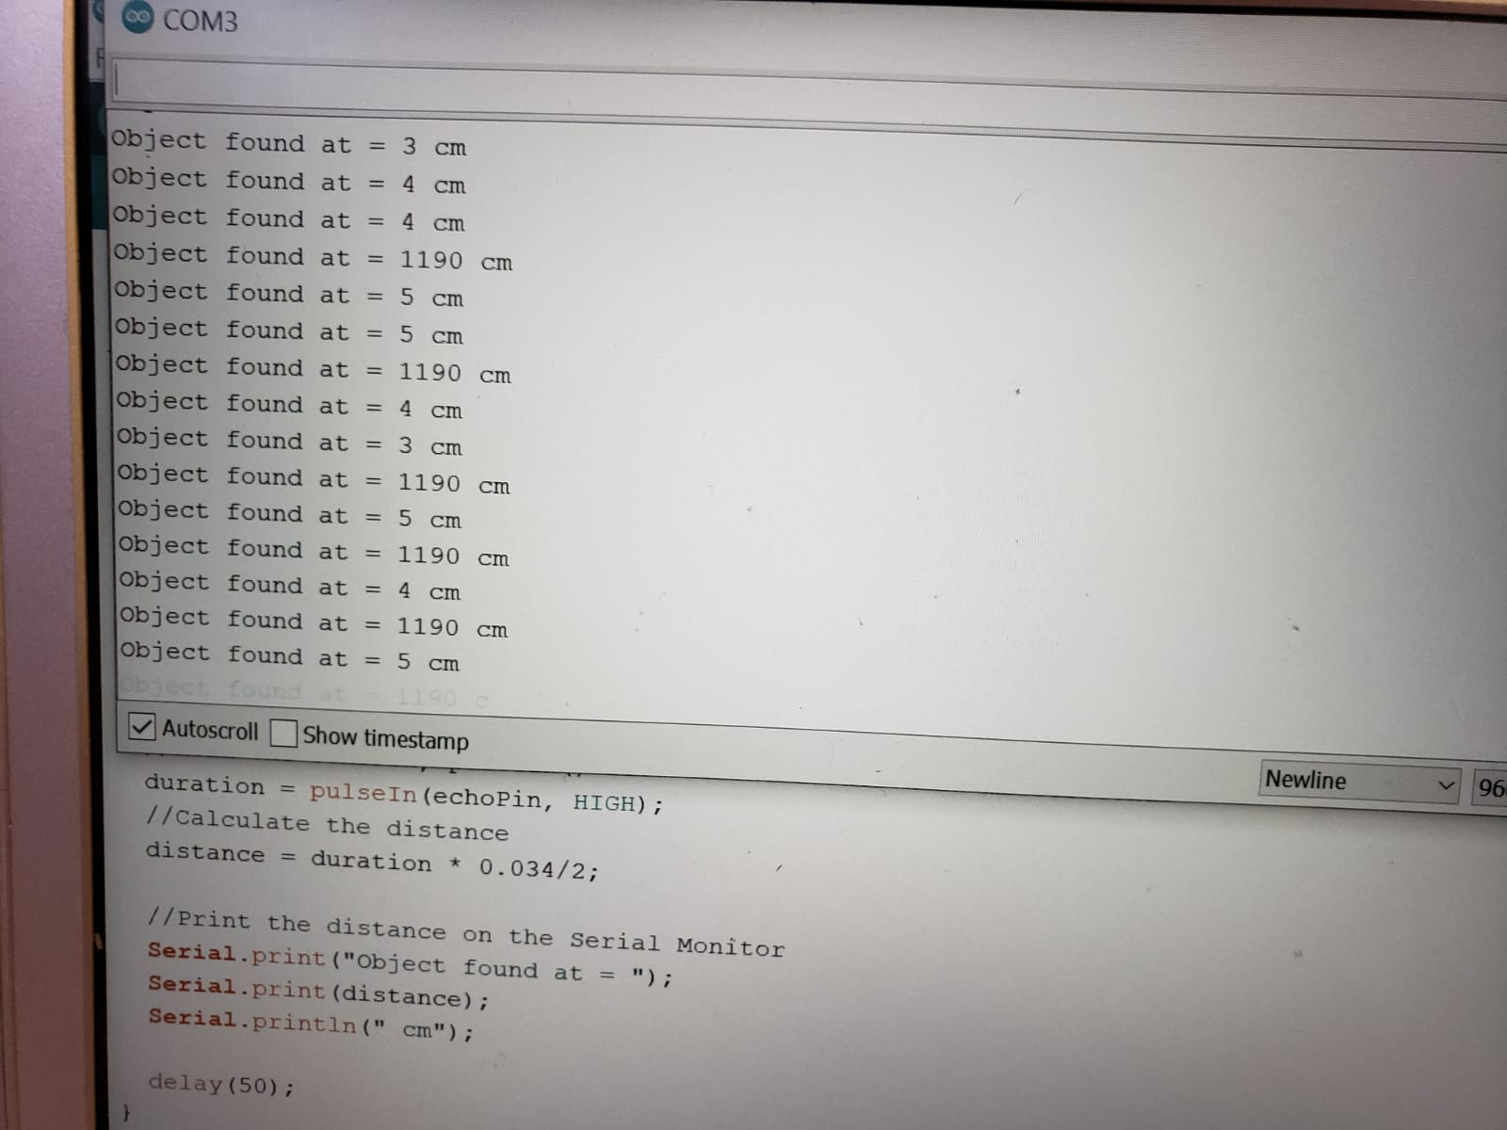

Calculated the distance between the sensor and the object by running a code in the Arduino IDE

Slide 10
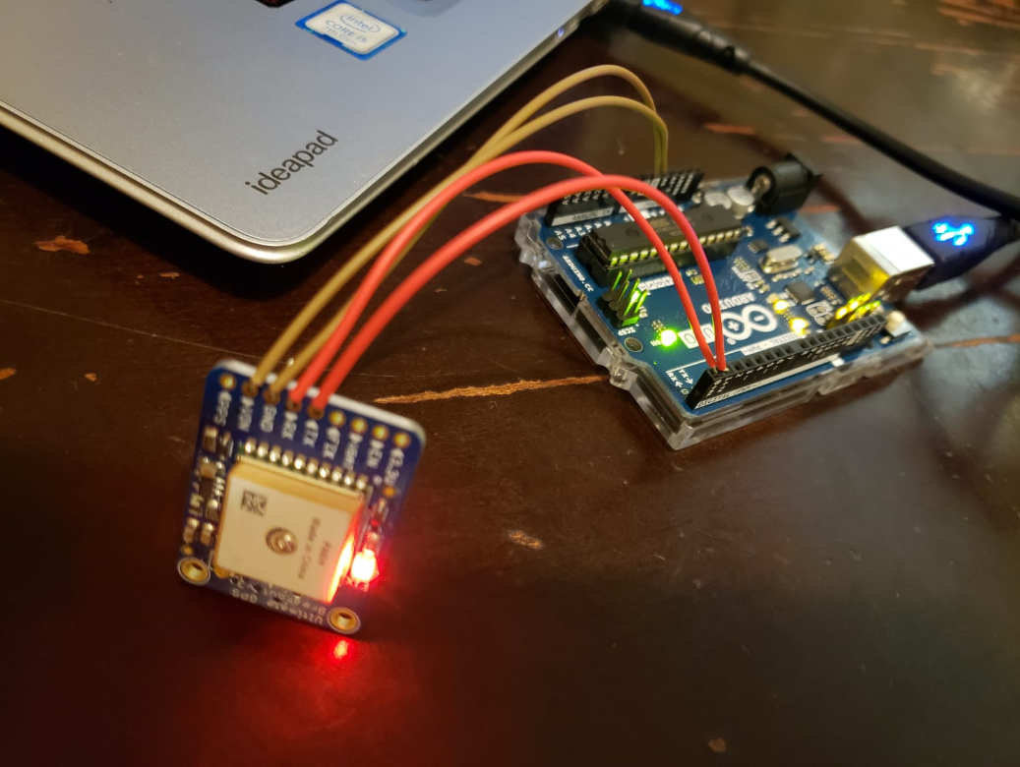
TESTING ADAFRUIT ULTIMATE GPS BREAKOUT MODULE
Testing completed by connecting GPS module with Arduino UNO
GPS connections
GPS Arduino
Vin ←→ 5V
TX ←→ TX
RX ←→ RX
GND ←→ GND
Tested by uploading an blank sketch into the Arduino and displayed the output on the serial monitor
The output was in the form of NMEA data

Slide 11
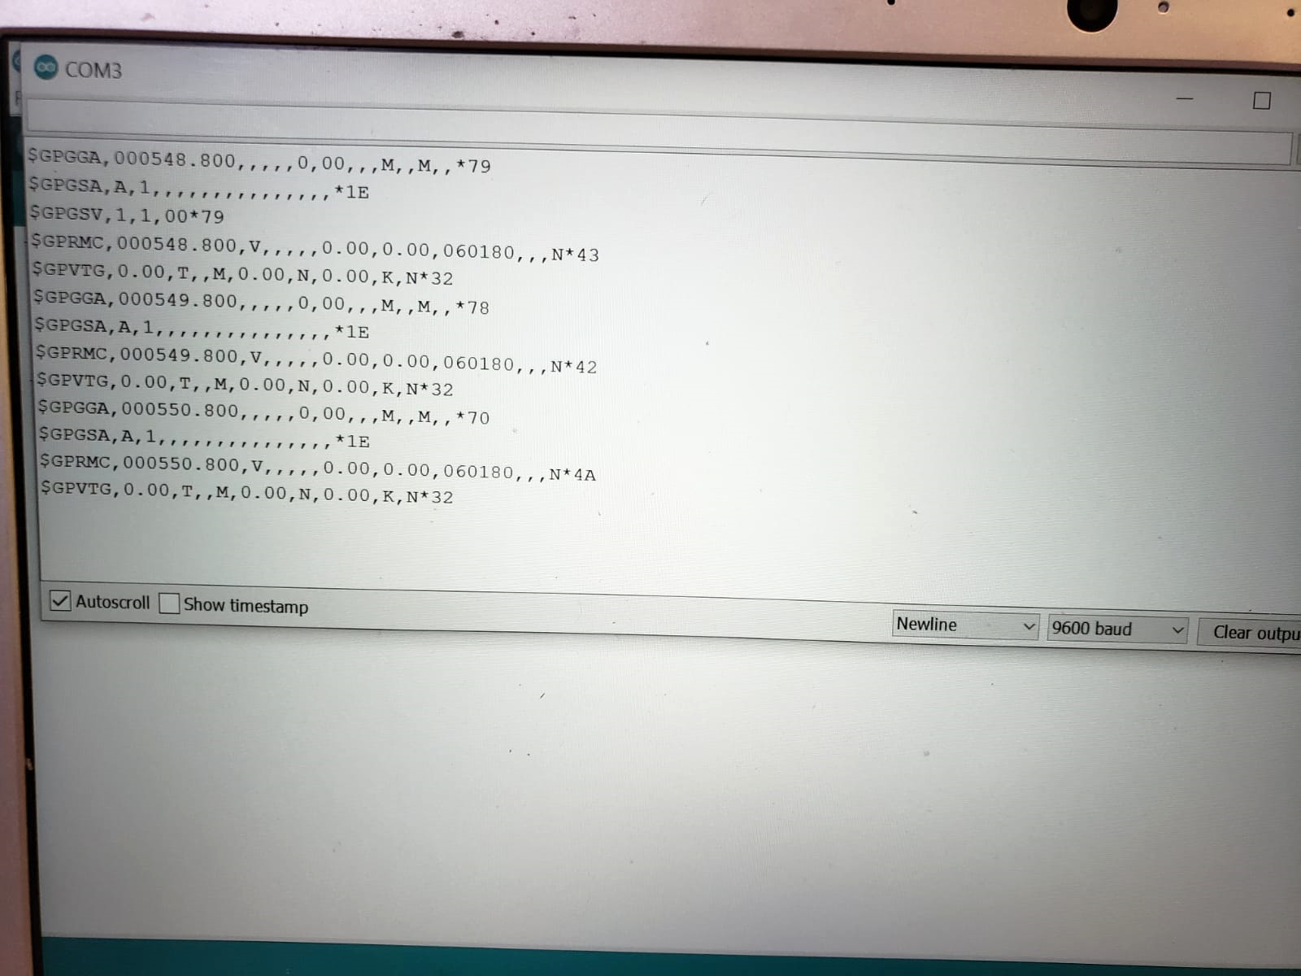
Output displayed on the serial monitor

Slide 12
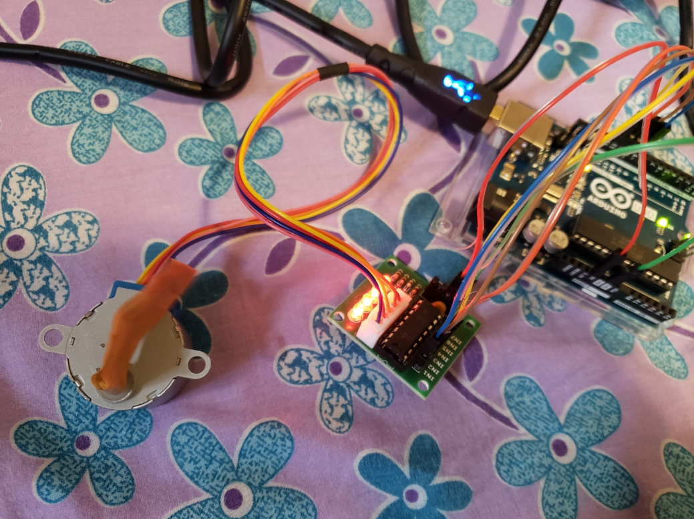
TESTING 28BYJ-48 STEPPER MOTOR AND ULN2003 DRIVER BOARD
28BYJ-48 stepper motor connected to Arduino using ULN2003 motor driver
Motor driver connections
ULN2003 Arduino
Vin ←→ 5V
Pin 1 ←→ Pin 9
Pin 2 ←→ Pin 10
Pin 3 ←→ Pin 11
Pin 4 ←→ Pin 12
GND ←→ GND

Slide 13
Connected Stepper motor to the motor driver using the cable
Tested the stepper motor by running a code in the Arduino IDE and obtained full rotation of motor as output

Slide 14
REFERENCES
Georgia Tech(2020). How to configure the Wifi on a BeagleBone Black wireless retrieved from https://fis.gatech.edu/how-to-configure-bbw-wifi/
Joseph(2020 May). Interface I2C 16x2 LCD with Arduino UNO retrieved from https://create.arduino.cc/projecthub/akshayjoseph666/interface-i2c-16x2-lcd-with-arduino-uno-just-4-wires-273b24
Bakker(2019). How to use an HC-SR04 Ultrasonic Distance Sensor with Arduino
retrieved from https://www.makerguides.com/hc-sr04-arduino-tutorial/
Adafruit(ND). Adafruit Ultimate GPS retrieved from https://learn.adafruit.com/adafruit-ultimate-gps/arduino-wiring?view=all
Rawashdeh(2018). BYJ48 Stepper Motor retrieved from https://www.instructables.com/id/BYJ48-Stepper-Motor/

